Slide 1


Search1- Complier vs interpreter vs transpiler)
Preparation1- conditions ( if & switch )

Slide 2
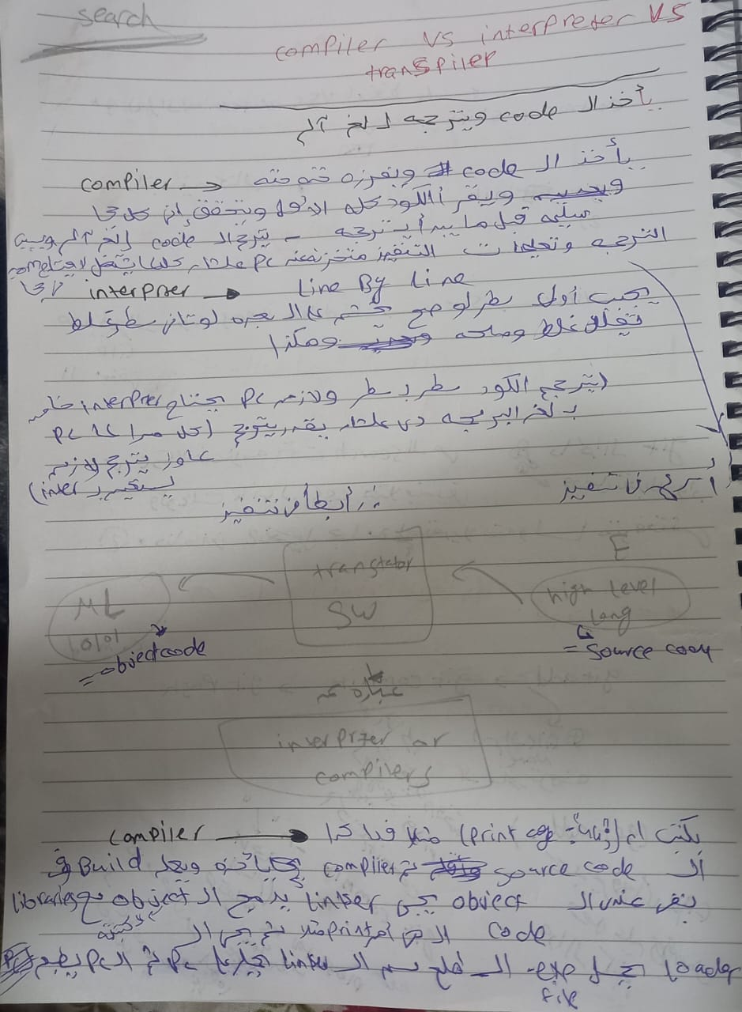

Slide 3
